Slide 1
Electrical Circuits Lecture 7: Basic RL and RC Circuits By: Mahmoud Momtazpour ceit.aut.ac.ir/~momtazpour
Amirkabir University of Technology

Slide 2
Topic Overview
Source-Free RL Circuit
Source-Free RC Circuit
Driven RL Circuit
Driven RC Circuit

Slide 3
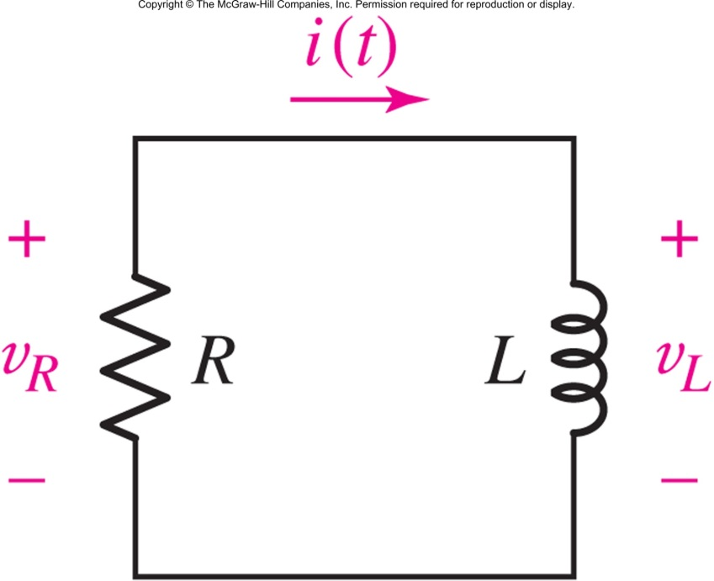
The Source-Free RL Circuit
Applying KVL:
We can solve for the natural response
if we know the initial condition i(0)=I₀:
i(t)=I₀e^{-Rt/L} for t>0
Notes:
Assume Aexp(st) as a solution and test it in the equation and obtain s=-R/L
Another solution is to form di/i = -R/L dt and obtain log of both side to reach: ln(i) = (-R/L)t + K →i = i0exp(-Rt/L)

Slide 4
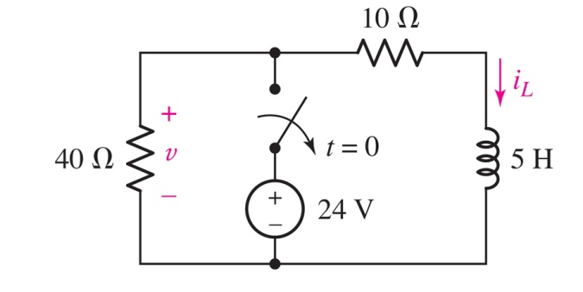
Example: RL with a Switch
Show that the voltage v(t) will be -12.99 volts at t=200 ms.

Slide 5
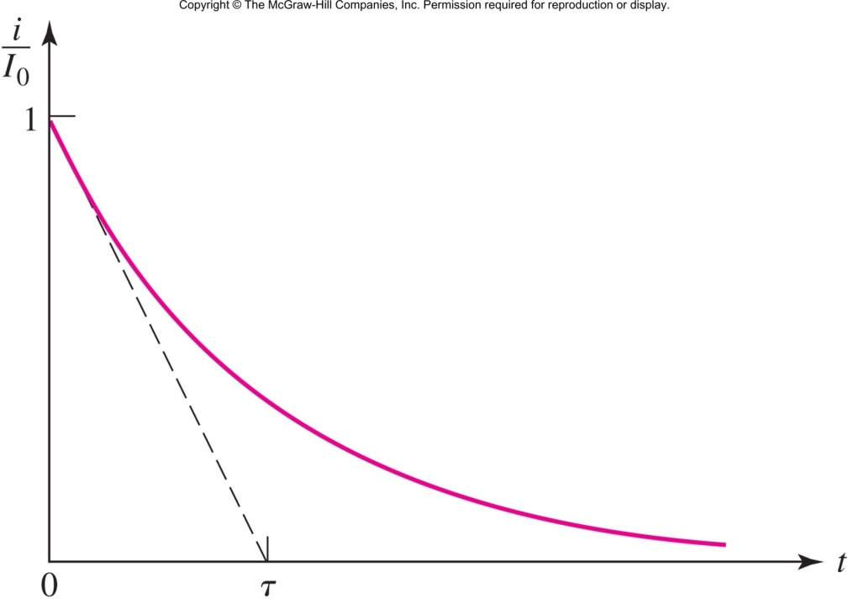
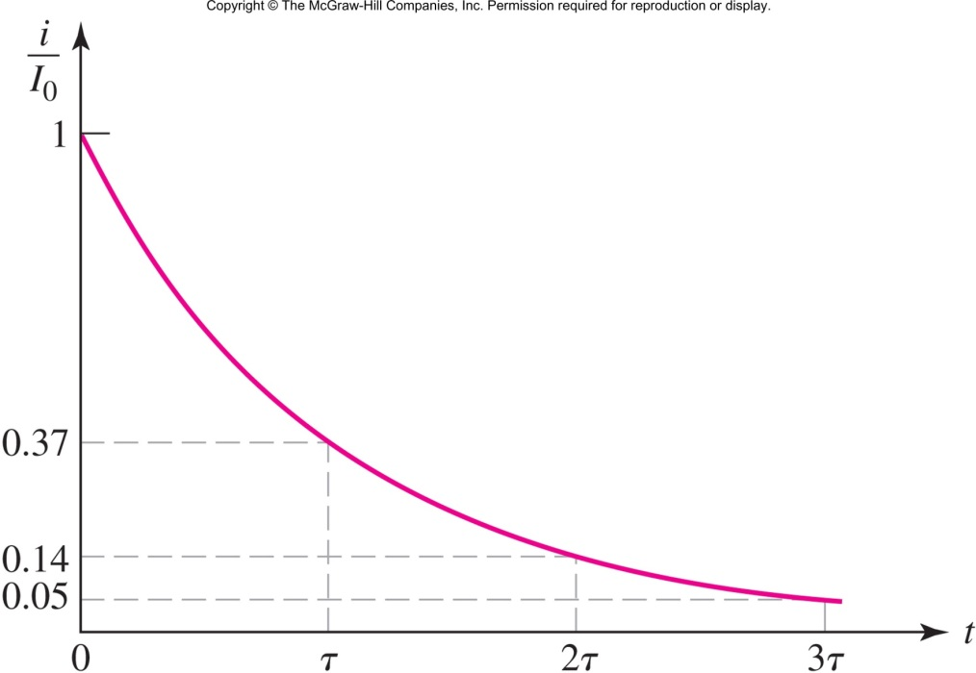
The Exponential Response
The time constant
τ=L/R
determines the rate of decay.

Slide 6
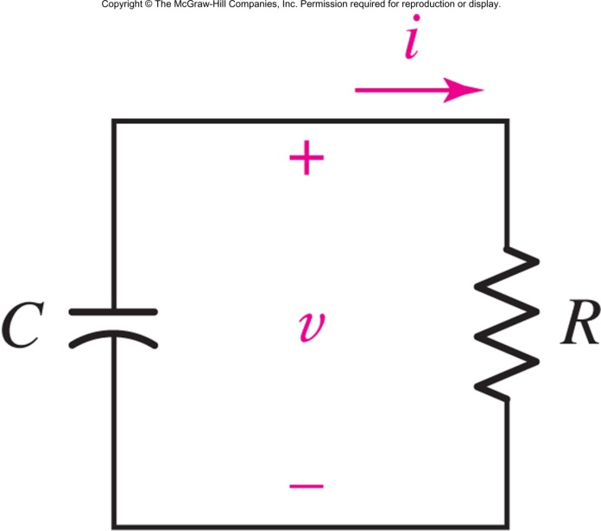
The Source-Free RC Circuit
Applying KCL:
We can solve for the natural response
if we know the initial condition v(0)=V₀
v(t)=V₀e^{-t/RC} for t>0

Slide 7
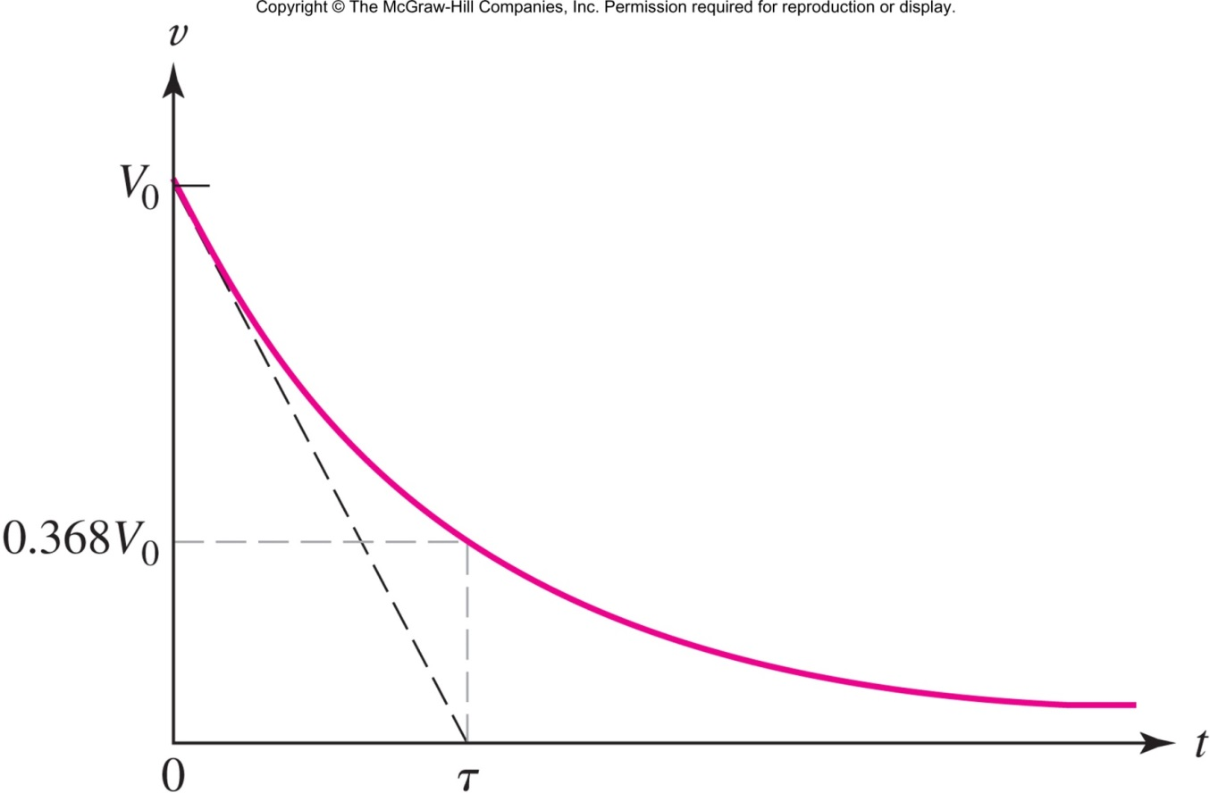
RC Natural Response
The time constant is
τ=RC

Slide 8
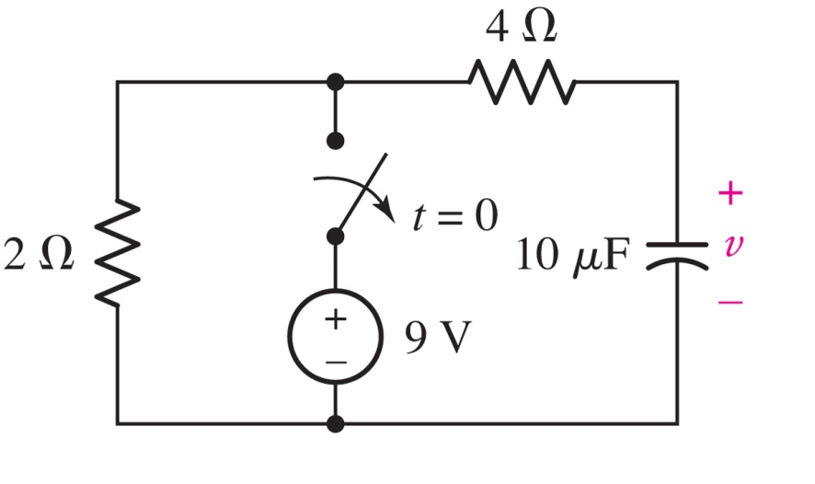
The Source Free RC Circuit
Show that the voltage v(t) is 321 mV at t=200 μs.

Slide 9
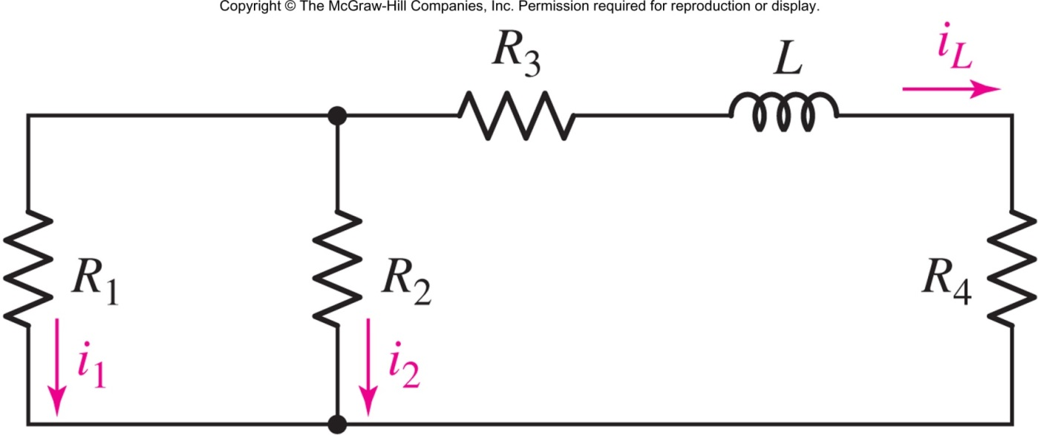
General RL Circuits
The time constant of a single-inductor circuit will be τ=L/R_{eq} where R_{eq} is the resistance seen by the inductor.
Example: R_{eq}=R₃+R₄+R₁R₂ / (R₁+R₂)

Slide 10
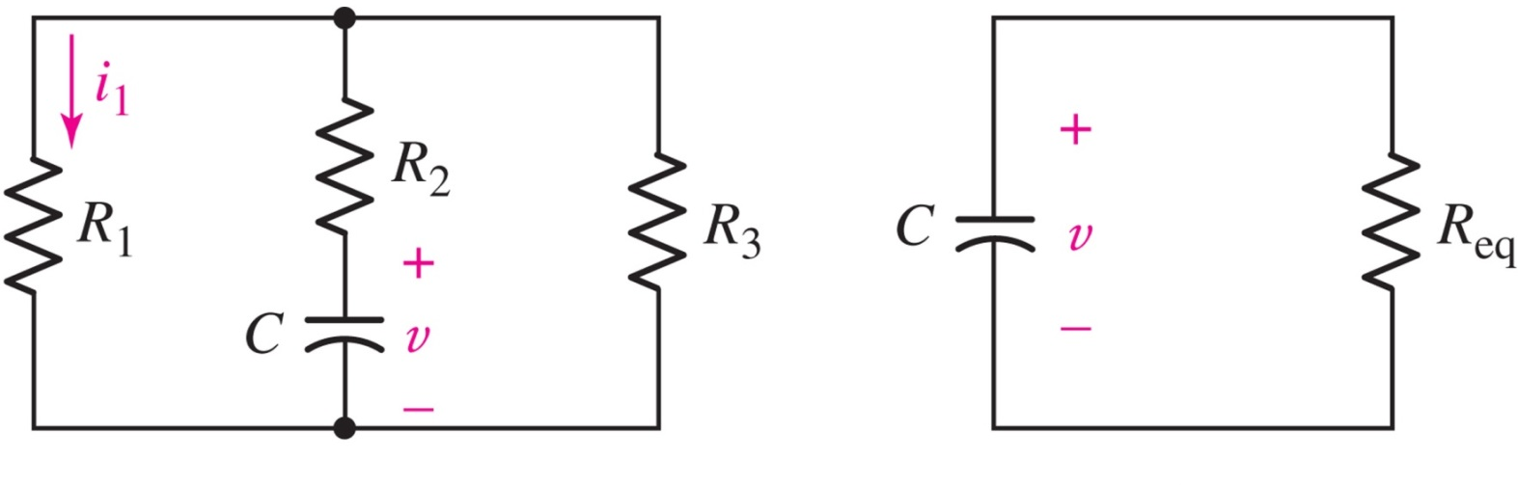
General RC Circuits
The time constant of a single-capacitor circuit will be τ=R_{eq}C where R_{eq} is the resistance seen by the capacitor.
Example: R_{eq}=R₂+R₁R₃ / (R₁+R₃)

Slide 11
1st Order Response Observations
The voltage on a capacitor or the current through a inductor is the same prior to and after a switch at t=0.
Resistor voltage (or current) prior to the switch v(0⁻) can be different from the voltage after the switch v(0⁺).
All voltages and currents in an RC or RL circuit follow the same natural response e^{-t/τ}.

Slide 12
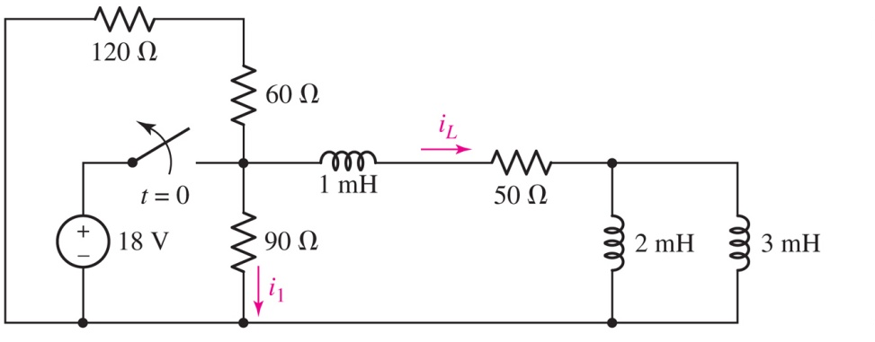
Example: L and R Current
Find i₁(t) and i_{L}(t) for t>0.
Answer: τ=20 μs; i₁=-0.24e^{-t/τ},i_{L}=0.36e^{-t/τ} for t>0

Slide 13
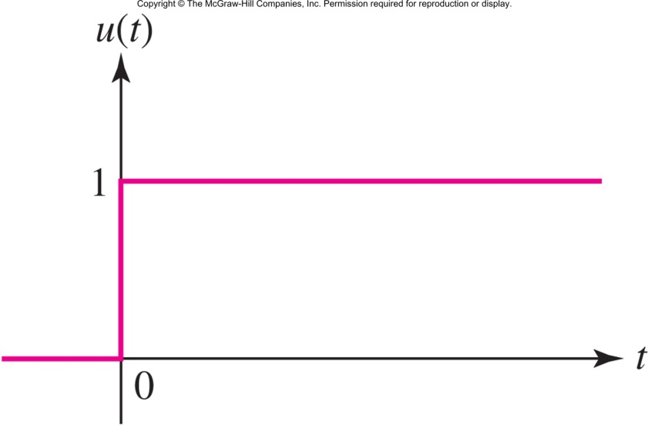
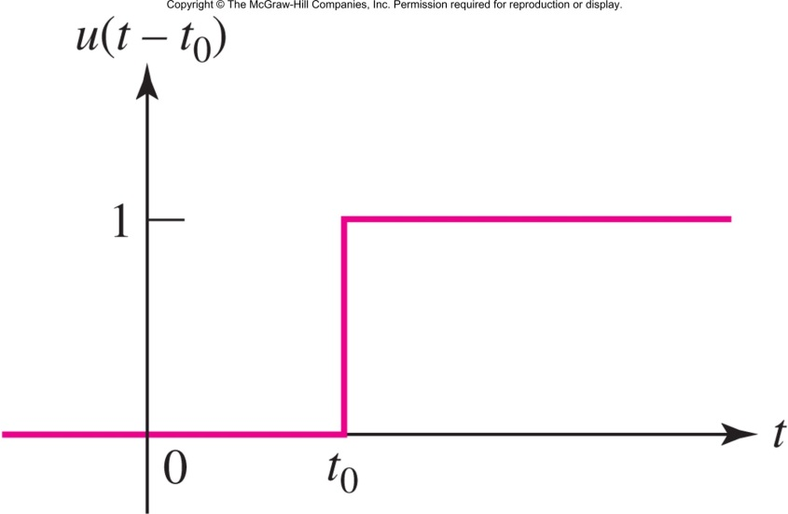
The Unit Step Function
The unit-step function u(t) is a convenient notation to represent change:

Slide 14
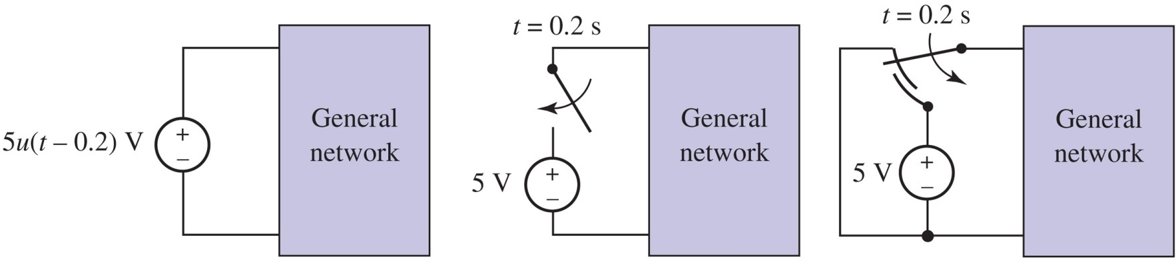
Switches and Steps
The unit step models a double-throw switch.
A single-throw switch is open circuit for t<0, not short circuit.

Slide 15
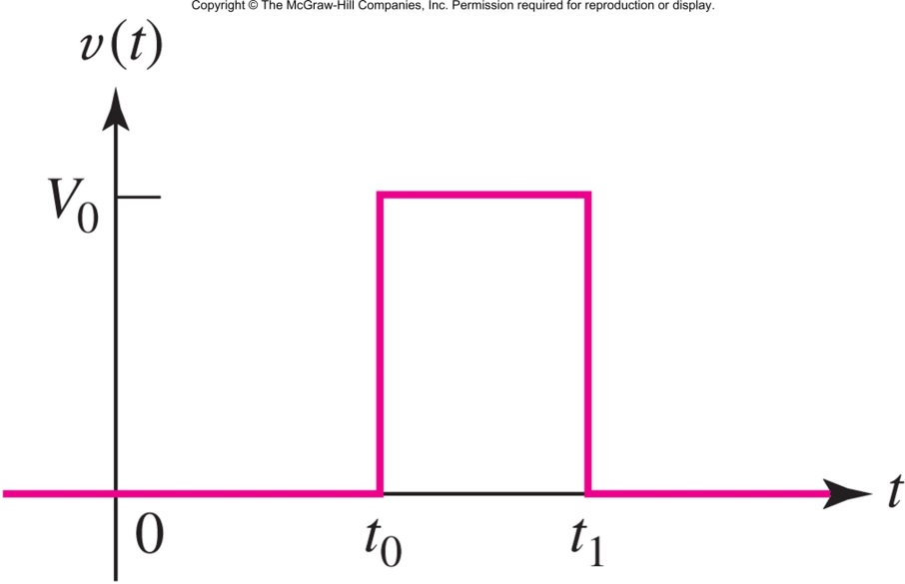
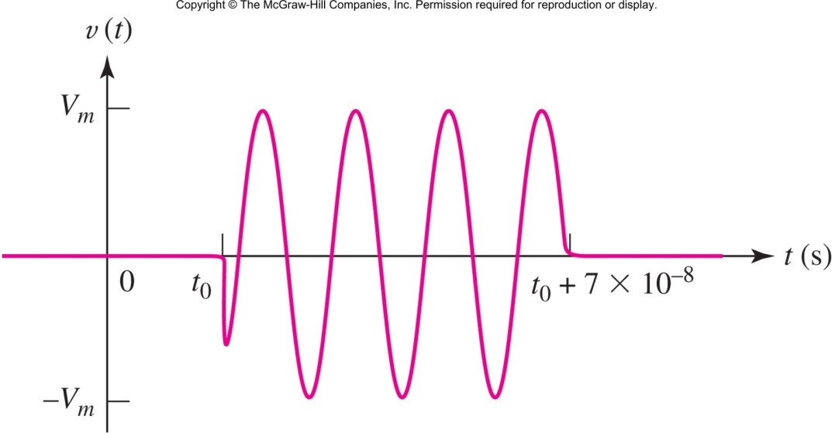
Modeling Pulses using u(t)
Rectangular pulse
Pulsed sinewave:

Slide 16
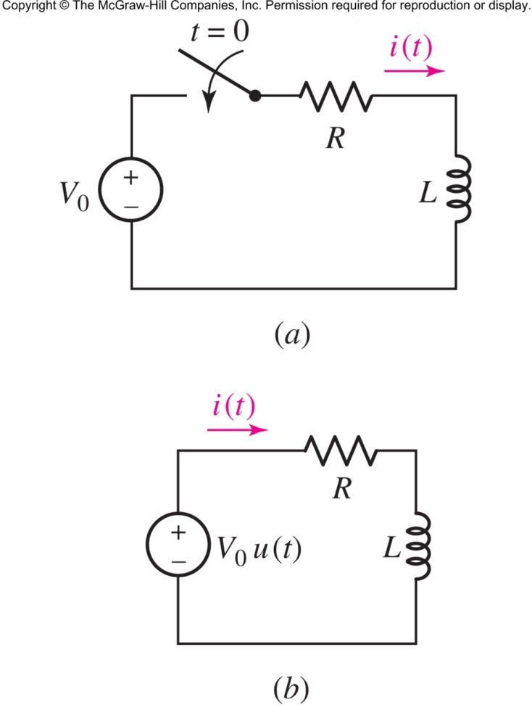

Driven RL Circuits
The two circuits shown both have i(t)=0 for t<0 and are also the same for t>0.
We now have to find both the natural response and the forced response due to the source V₀
Notes:
One can form di/(V0-Ri) = dt/L and obtain log of both side to reach: ln(V0-Ri) = (-R/L)t + K →i = V0/R(1-exp(-Rt/L))
Another solution is to derive R+Ls = 0 → s=-R/L and form the natural response as i = Aexp(-Rt/L) and add it to the forced response i=K. After adding both terms and testing it with the initial point (i(0) = 0) and final point(i(∞)=V0/R), K would be V0/R and A would be –V0/R

Slide 17
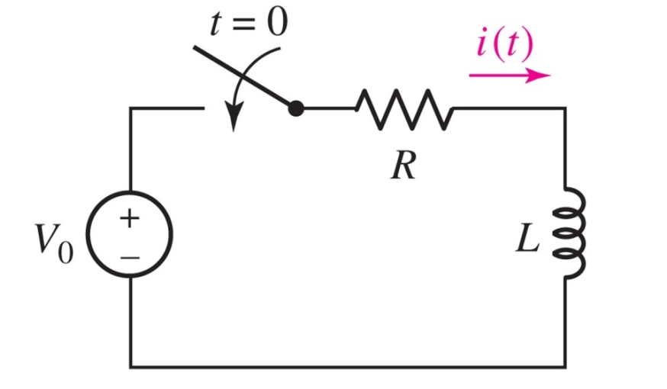
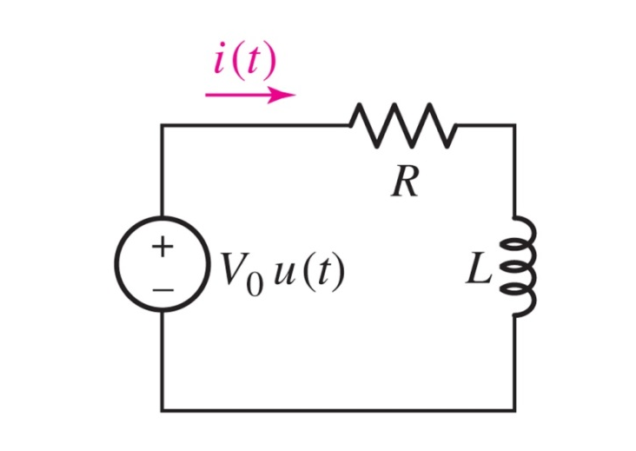
Driven RL Circuits
The total response is the combination of the transient/natural response
and the forced response:

Slide 18
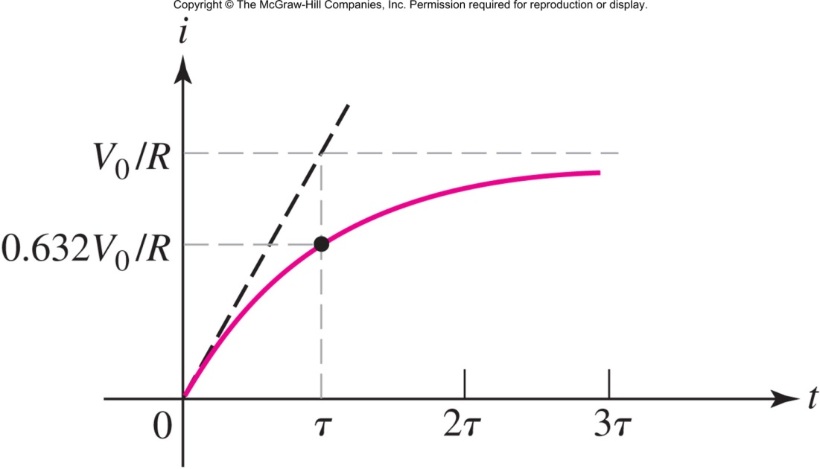
Driven RL Circuits

Slide 19
Total Response
What if the circuit has both initial condition and source? Two solutions:
Apply superposition
Total Response = Source-free response + Driven Response
or, simply solve the differential equations:
Total Response = Natural response + Forced Response
Remove the source, Just consider the initial condition
Keep the source, set the initial condition to zero

Slide 20

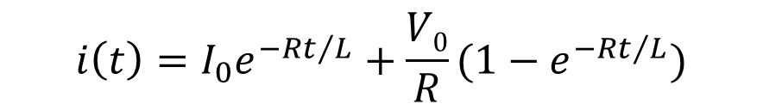
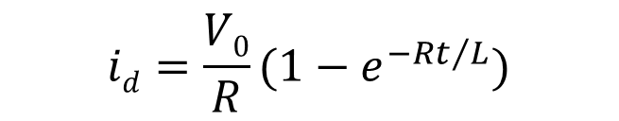
Example
i(0⁻)=I₀, Find i(t)
Superposition:
Source free response:
Driven response:
Total response:
$$isf=I_{0}e^{−Rt/L}$$
$$id=\frac{V0}{R}{(1−e}^{−Rt/L})$$
$$i\left(t\right)=I_{0}e^{−Rt/L}+\frac{V0}{R}{(1−e}^{−Rt/L})$$

Slide 21
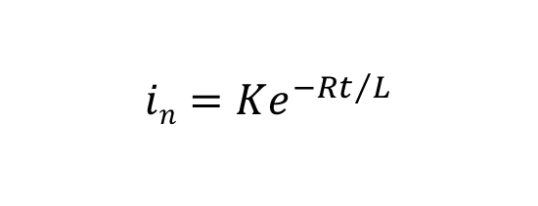



Example
i(0⁻)=I₀, Find i(t)
Solve equations:
Natural response:
Forced response:
Total response:
$$i^{′}+\frac{R}{L}i=\frac{V0}{L}, i\left(0\right)=I0$$
$$in=Ke^{−Rt/L}$$
$$if=\frac{V0}{R}$$
$$i\left(t\right)=Ke^{−Rt/L}+\frac{V0}{R}$$
$$i\left(0\right)=I0→K=I0−\frac{V0}{R}, i\left(t\right)=\frac{V0}{R}+(I0−\frac{V0}{R}{)e}^{−Rt/L}$$

Slide 22
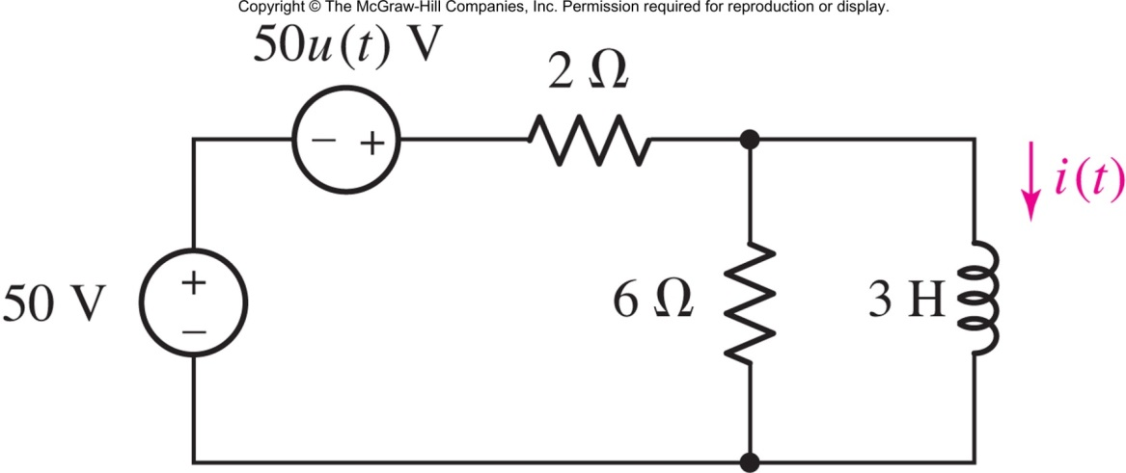
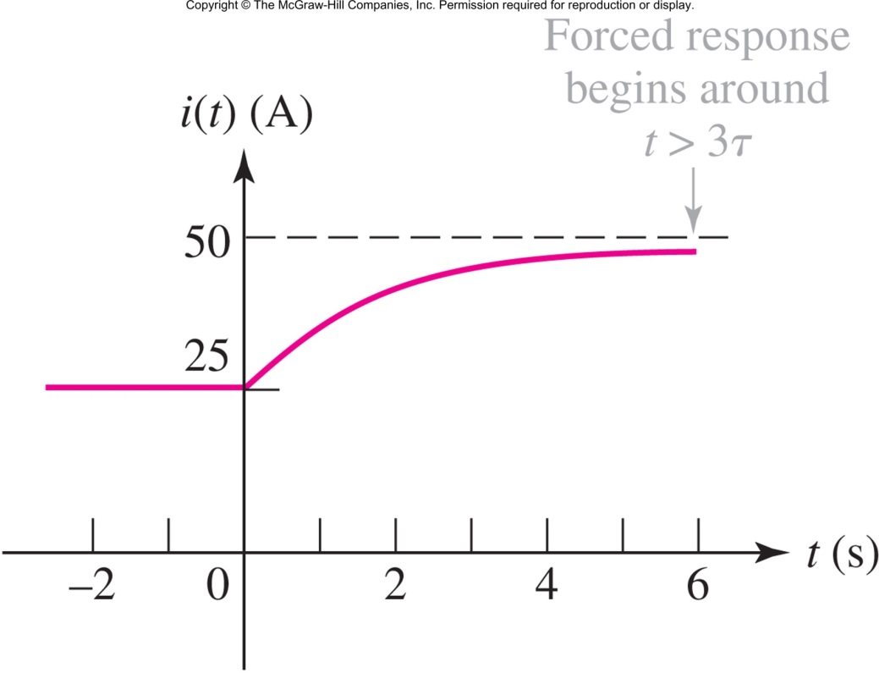
Example: RL Circuit with Step
Find i(t)
i(t)=25+25(1-e^{-t/2})u(t) A

Slide 23
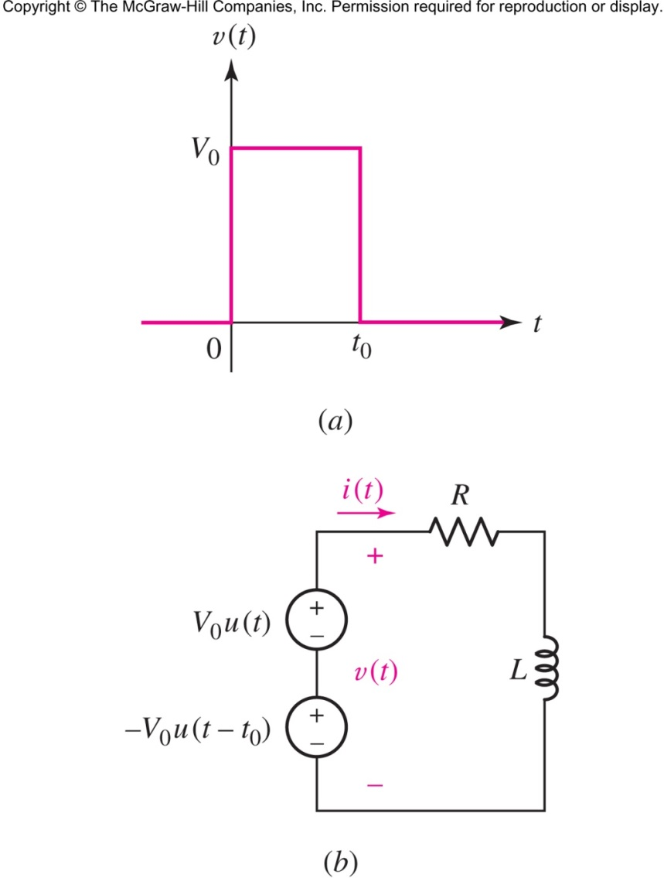
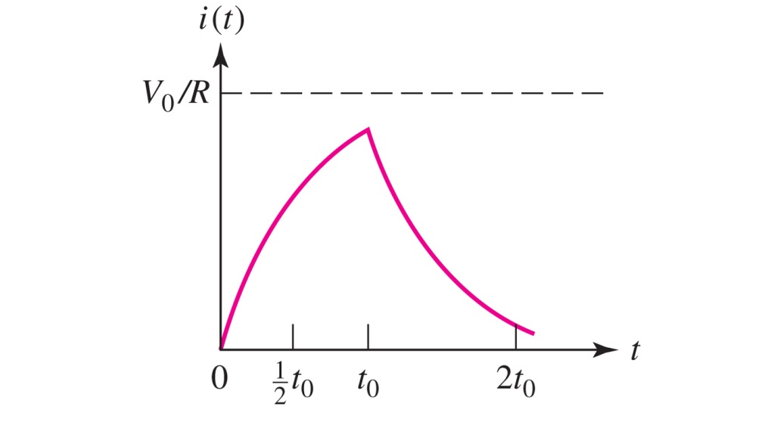
Example: Voltage Pulse

Slide 24
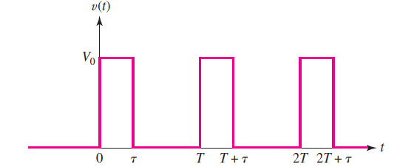
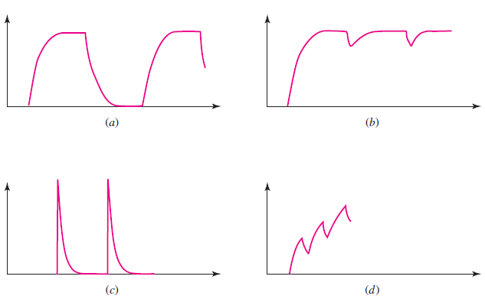
Response to Voltage Pulse
What if τ>>RC or τ<<RC
τ>>RC
T-τ>>RC
τ>>RC
T-τ<<RC
τ<<RC
T-τ>>RC
τ<<RC
T-τ<<RC

Slide 25
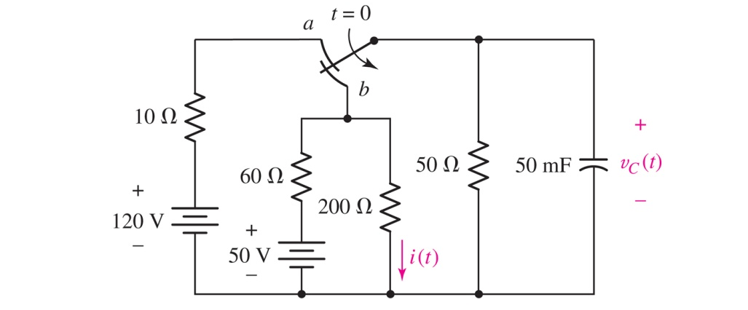
Driven RC Circuits (part 1 of 2)
v_{C}= 20 + 80e^{-t/1.2} V and
i= 0.1 + 0.4e^{−t/1.2} A

Slide 26
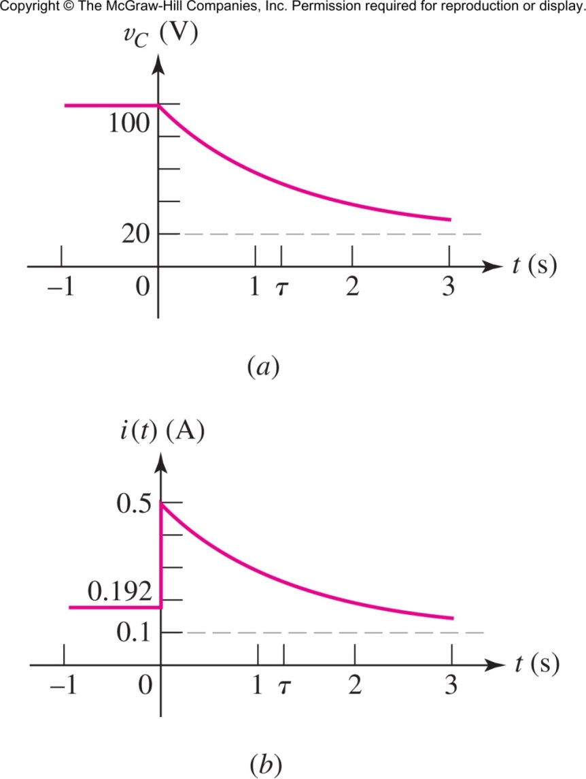
Driven RC Circuits (part 2 of 2)
v_{C}=20 + 80e^{-t/1.2} V
i=0.1 + 0.4e^{−t/1.2} A

Slide 27
AC Sources
When the source is not DC (i.e. Time Variant)
natural response is the same (e.g. Ke^{st})
forced response is similar to the source
with different coefficients
Source | Natural Response
K | K’
K₁t+K₂ | K’t+k”
Ke^{bt} (b!=s) | K’e^{bt}
Ke^{bt} (b==s) | K’te^{bt}
Kcos(wt+p) | K’cos(wt+p’)

Slide 28
In-Class Exercise
Find i₁(t) and i₂(t) for the given circuit
L₁ = 6H, i₁(0) = 2A
L₂ = 3H, i₂(0) = 1A
R = 6Ω
Answer:
i1(t) = e(-3t)+1, i2(t) = 2e(-3t)-1
i₁
i₂
Hint: V_{L1}=V_{L2} → L₁i₁’=L₂i₂’→ L₁i₁=L₂i₂+K

Slide 29
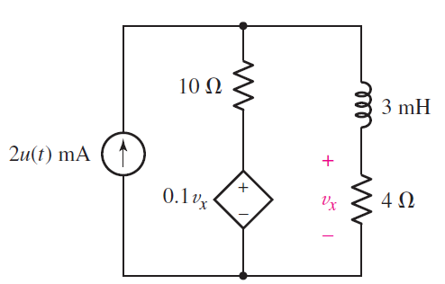
In-Class Exercise 2
Find v_{x}(t) for the given circuit
Answer:
vx(t) = 5.9m(1-e^(-4.5mt))

Slide 30
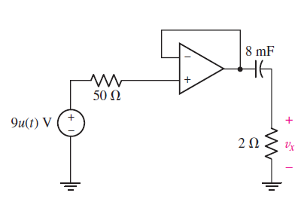
In-Class Exercise 3
Find v_{x}(t) for the given circuit

Slide 31
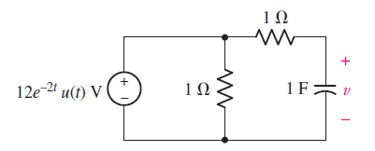



In-Class Exercise 4
Find v(t) for the given circuit
Answer1:
What if the source is
Answer2:
$$v(t)=12\left(e^{−t}−e^{−2t}\right)u(t)$$
$$12e^{−t}u(t)$$
$$v\left(t\right)=12te^{−t}u(t)$$

Slide 32
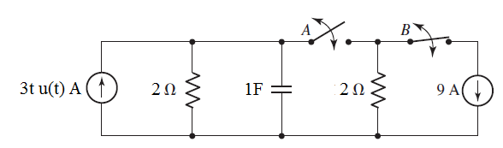
In-Class Exercise 5
Find v_{C}(t)
Assume that A and B are initially closed
B opens at 1s, then A opens at 2s

Slide 33
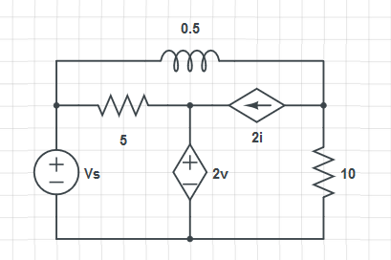
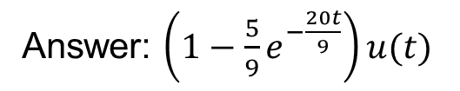
In-Class Exercise 6
Answer: $\left(1−\frac{5}{9}e^{−\frac{20t}{9}}\right)u(t)$
Find v(t) if v_{s}=u(t)
What if v_{s}=cos(t)u(t)
i
+
v
-

Slide 34
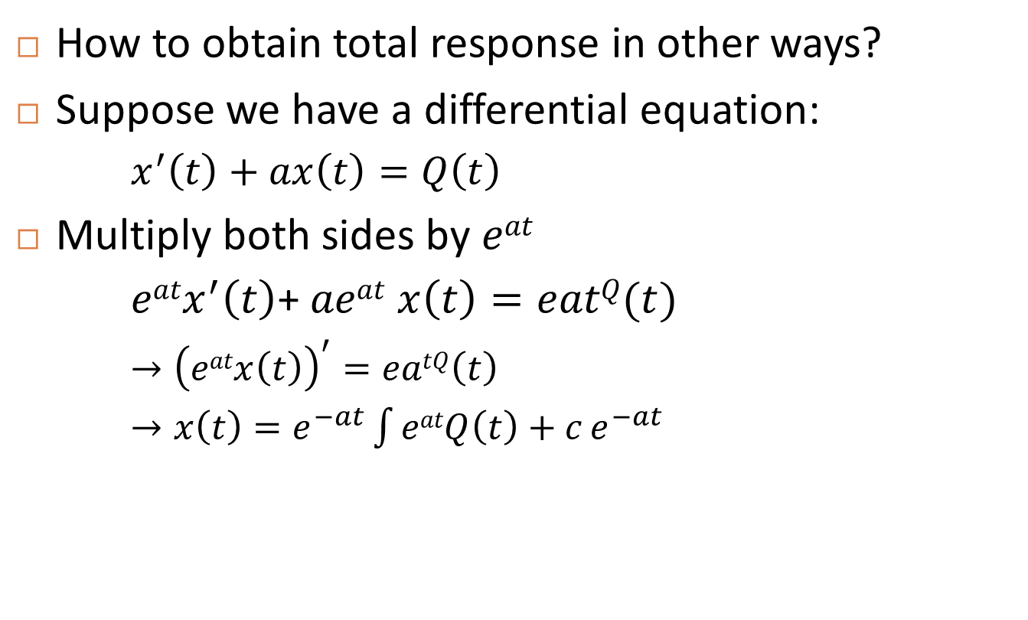
Total Response
How to obtain total response in other ways?
Suppose we have a differential equation:
$x^{′}\left(t\right)+ax\left(t\right)=Q\left(t\right)$
Multiply both sides by $eat$
$eatx^{′}\left(t\right)$+ $aeat$ $x\left(t\right)=eatQ(t)$
$→{\left(eatx\left(t\right)\right)}^{′}=eatQ\left(t\right)$
$→x\left(t\right)=e^{−at}\int{eatQ\left(t\right)+c}e^{−at}$
Forced response
Natural response

Slide 35
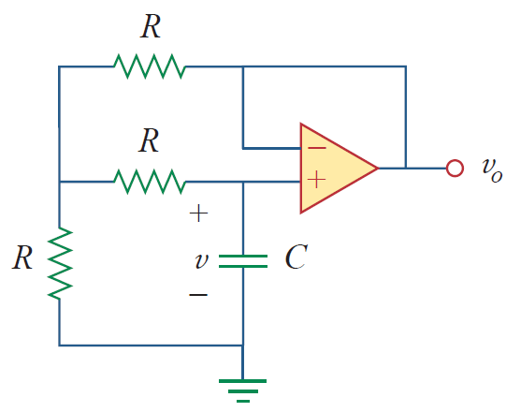
Quiz
If v(0)=10, find v_{o}(t) for t>0

